Slide 1
MITRE ATT&CK framework

Slide 2
網路攻擊鏈
Cyber Kill Chain

Slide 3
網路攻擊鏈 Cyber Kill Chain
名稱 | 意義
偵查 Reconnaissance | 選擇目標，對其進行研究，然後嘗試識別目標網絡中的漏洞。
武裝 Weaponization | 創建針對一種或多種漏洞的遠程訪問惡意軟件， 例如:病毒或蠕蟲。
交付 Delivery | 將病毒傳輸到目標 例如:通過電子郵件附件或網站 APT
漏洞利用 Exploitation | 是利用程序中的某些漏洞，來得到計算機的控制權 MS08-067 SMB
安裝 Installation | 惡意軟體安裝在入侵者可以使用的訪問點
命令與控制 C&C Command and Control | 將命令發送到被惡意軟件感染系統和接收來自目標網絡竊取的數據或網絡犯罪。
行動目標 Actions on Objective | 入侵者會採取行動來實現其目標。 例如數據洩露，數據破壞或贖金加密。
https://en.wikipedia.org/wiki/Kill_chain

Slide 4
路由器、網路攝影機安全性不足，友訊遭美國政府告上法院
FTC指出友訊在文宣行銷上強調產品的安全性，但旗下的路由器、
網路攝影機卻有不難防護的安全瑕疵，置消費者的隱私及安全於風險中，
已向法院控告。友訊則否認FTC的指控，將提出抗告。
文/林妍溱 | 2017-01-06發表
https://www.ithome.com.tw/news/110963

Slide 5
79款Netgear路由器含有允許駭客執行任意程式的安全漏洞
ZDI表示漏洞存在於Netgear路由器的httpd服務中，影響R6700系列產品，
另一名發現同樣漏洞的資安研究人員Adam Nichols，則利用自動偵測工具，
發現79款Netgear路由器的758個韌體都存在此漏洞。
由於Netgear在今年1月接獲ZDI通報後，截至6月15日仍未完成修補，
ZDI建議使用者透過防火牆或白名單功能，
規定只有受信賴的裝置才能存取httpd服務
文/陳曉莉 | 2020-06-20發表
https://www.ithome.com.tw/news/138349

Slide 6
網路攻擊鏈Cyber Kill Chain
名稱 | 意義
偵查 Reconnaissance | 研究、識別及選擇目標，可以在網際網路上搜尋相關資訊，或是利用工具掃描或探測目標環境。
武裝 Weaponization | 針對特定的安全漏洞，設計遠端存取木馬程式，包裹在可遞送的資料中，多數以自動化工具產生。 且利用最常見的資料檔案進行偽裝，如 PDF 檔或 DOC 檔。
傳遞 Delivery | 駭客將武器傳輸到攻擊目標環境。 例如:電子郵件附件、網站及 USB 儲存媒體。
弱點攻擊 Exploitation | 武器遞送到目標主機後，將觸發內部的程式碼，以應用程式或作業系統的安全弱點為目標，開始進行攻擊。
安裝 Installation | 於受駭主機安裝遠端存取的木馬或後門程式，而攻擊者可繼續隱藏於受駭環境中。
命令與控制 Command and Control | APT 攻擊經常需要手動控制，受駭主機須向外連結網際網路上的控制伺服器， 以建立 C2 通道；攻擊者便可利用此通道操控受駭主機，彷彿親臨現場操作鍵盤。
採取行動 Actions on Objectives | 經過前面 6 個階段的鋪陳，攻擊者才真正開始採取行動，如竊取資料、當成入侵其他系統的跳板。
https://www.fisc.com.tw/Upload/2e644695-04a9-44cf-8841-80936503cc5a/TC/9402.pdf

Slide 7
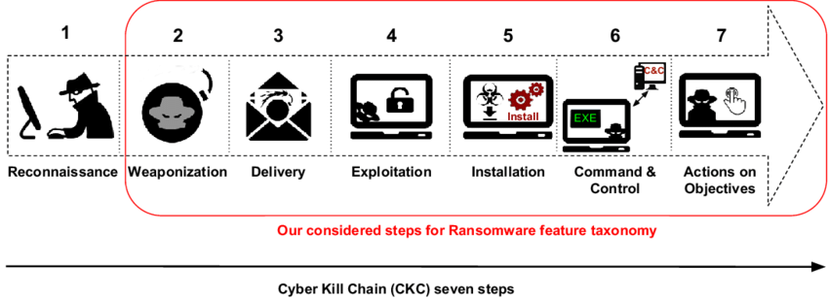
網路攻擊鏈Cyber Kill Chain
步驟 | 名稱 | 意義
1 | 偵查 Reconnaissance | 選擇目標，對其進行研究，然後嘗試識別目標 網絡中的漏洞。
2 | 武裝 Weaponization | 創建針對一種或多種漏洞的遠程訪問惡意軟件，例如:病毒或蠕蟲。
3 | 交付 Delivery | 將病毒傳輸到目標 例如:通過電子郵件附件或網站

Slide 8
網路攻擊鏈Cyber Kill Chain
步驟 | 名稱 | 意義
4 | 漏洞利用 Exploitation | 是利用程序中的某些漏洞，來得到計算機的控制權。
5 | 安裝 Installation | 惡意軟體安裝在入侵者可以使用的訪問點。
6 | 命令與控制 Command and Control | 將命令發送到被惡意軟件感染系統和接收來自目標網絡竊取的數據或網絡犯罪。
7 | 行動目標 Actions on Objective | 入侵者會採取行動來實現其目標。 例如數據洩露，數據破壞或贖金加密。

Slide 9
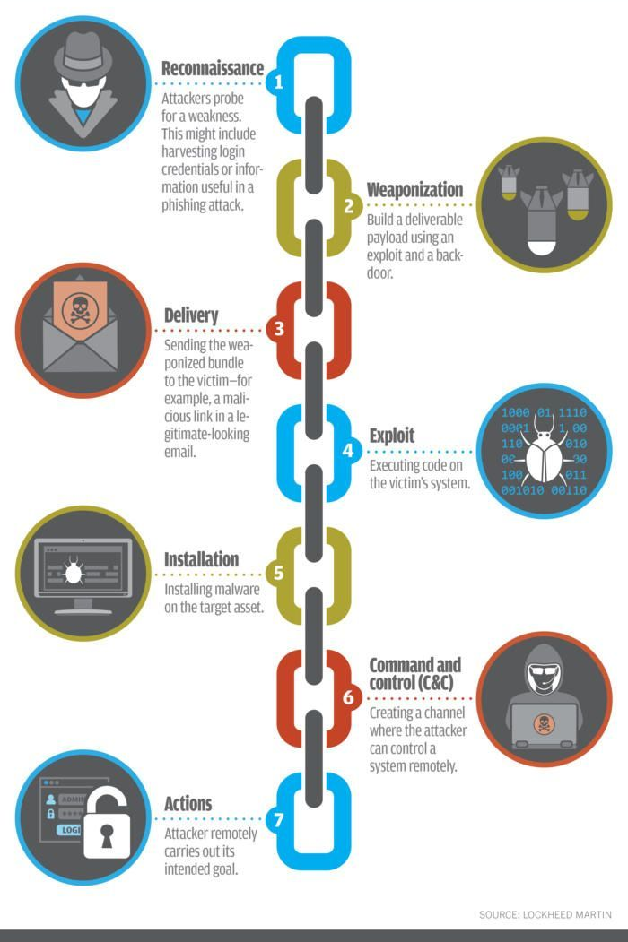
網路攻擊鏈Cyber Kill Chain

Slide 10
有關網路攻擊鏈Cyber Kill Chain,
下列敘述何者為非?
A.
B.
C.
D.

Slide 11
MITRE ATT&CK框架

Slide 12
MITRE ATT&CK
MITRE2013年推出了ATT&CK模型
根據真實的觀察數據來描述和分類對抗行為。
ATT&CK將已知攻擊者行為轉換為結構化列表，將這些已知的行為匯總成戰術()和技術()，並通過幾個矩陣以及結構化威脅信息表達式（STIX）、指標信息的可信自動化交換（TAXII）來表示。
由於此列表相當全面地呈現了攻擊者在攻擊網絡時所採用的行為，因此對於各種進攻性和防禦性度量、表示和其他機制都非常有用。
https://kknews.cc/tech/q92v8go.html

Slide 13
用MITRE ATT&CK框架識別攻擊鏈，
讓入侵手法描述有一致標準
由MITRE提出的ATT&CK資安框架，不僅是讓威脅入侵的描述具有更一致的標準，
成為有助於理解攻擊者具備能力的知識庫，並能為攻防演練帶來幫助。而且，在去年的ATT＆CK評估計畫中，
可進一步成為衡量安全產品的方式，目前已有9家業者端點安全產品參與。
文/羅正漢 | 2019-03-03發表
https://www.ithome.com.tw/news/129054

Slide 14
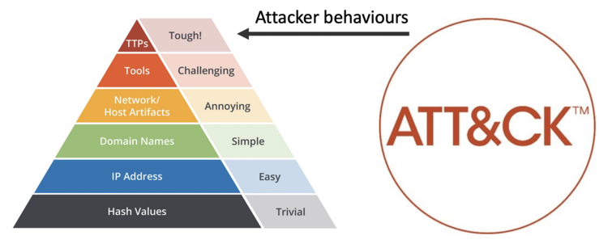
TTPs (Tactics, Techniques and Procedures)
Tactics: the adversary’s technical goals.
Techniques: how the goals are achieved.
Procedures: specific technique implementation.

Slide 15
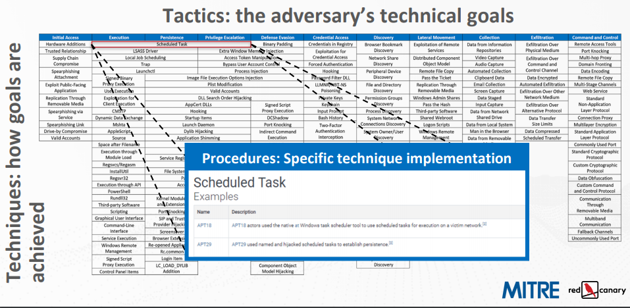
MITRE ATT&CK框架

Slide 16

https://www.ithome.com.tw/article/131277
MITRE ATT&CK框架

Slide 17
駭客在入侵駭客使用的戰略Tactics ，畫分成12個階段：包括
入侵初期Initial Access
執行Execution
持續潛伏Persistence
權限提升Privilege Escalation
防禦逃脫Defense Evasion
憑證存取Credential Access
發現（Discovery）、
橫向移動（Lateral Movement）、
收集（Collection）、
命令與控制Command and Control、
滲出（Exfiltration）
衝擊Impact

Slide 18
入侵初期Initial Access
The adversary is trying to get into your network.
Initial Access consists of techniques that use various entry vectors to gain their initial foothold within a network.
Techniques used to gain a foothold include targeted spearphishing and exploiting weaknesses on public-facing web servers.
Footholds gained through initial access may allow for continued access, like valid accounts and use of external remote services, or may be limited-use due to changing passwords.

Slide 19
執行Execution
Execution consists of techniques that result in adversary-controlled code running on a local or remote system.
Techniques that run malicious code are often paired with techniques from all other tactics to achieve broader goals, like exploring a network or stealing data.
For example, an adversary might use a remote access tool to run a PowerShell script that does Remote System Discovery.
https://attack.mitre.org/tactics/TA0002/

Slide 20
持續潛伏Persistence
The adversary is trying to maintain their foothold.
Persistence consists of techniques that adversaries use to keep access to systems across restarts, changed credentials, and other interruptions that could cut off their access.
Techniques used for persistence include any access, action, or configuration changes that let them maintain their foothold on systems
such as replacing or hijacking legitimate code or adding startup code.

Slide 21
權限提升Privilege Escalation
The adversary is trying to gain higher-level permissions.
Privilege Escalation consists of techniques that adversaries use to gain higher-level permissions on a system or network.
Adversaries can often enter and explore a network with unprivileged access but require elevated permissions to follow through on their objectives.
Common approaches are to take advantage of system weaknesses,

Slide 22
防禦脫逃Defense Evasion
Defense Evasion consists of techniques that adversaries use to avoid detection throughout their compromise.
Techniques used for defense evasion include uninstalling/disabling security software or obfuscating/encrypting data and scripts.
Adversaries also leverage and abuse trusted processes to hide and masquerade their malware.
Other tactics’ techniques are cross-listed here when those techniques include the added benefit of subverting defenses.

Slide 23
憑證存取Credential Access
Credential Access consists of techniques for stealing credentials like account names and passwords.
Techniques used to get credentials include keylogging or credential dumping.
Using legitimate credentials can give adversaries access to systems, make them harder to detect, and provide the opportunity to create more accounts to help achieve their goals.

Slide 24
發現Discovery
Discovery consists of techniques an adversary may use to gain knowledge about the system and internal network.
These techniques help adversaries observe the environment and orient themselves before deciding how to act.
They also allow adversaries to explore what they can control and what’s around their entry point in order to discover how it could benefit their current objective.
Native operating system tools are often used toward this post-compromise information-gathering objective.

Slide 25
橫向移動Lateral Movement
Lateral Movement consists of techniques that adversaries use to enter and control remote systems on a network.
Following through on their primary objective often requires exploring the network to find their target and subsequently gaining access to it.
Reaching their objective often involves pivoting through multiple systems and accounts to gain.
Adversaries might install their own remote access tools to accomplish Lateral Movement or use legitimate credentials with native network and operating system tools, which may be stealthier.

Slide 26
收集Collection
Collection consists of techniques adversaries may use to gather information and the sources information is collected from that are relevant to following through on the adversary's objectives.
Frequently, the next goal after collecting data is to steal (exfiltrate) the data.
Common target sources include various drive types, browsers, audio, video, and email.
Common collection methods include capturing screenshots and keyboard input.

Slide 27
命令與控制Command and Control
The adversary is trying to communicate with compromised systems to control them.
Command and Control consists of techniques that adversaries may use to communicate with systems under their control within a victim network.
Adversaries commonly attempt to mimic normal, expected traffic to avoid detection.
There are many ways an adversary can establish command and control with various levels of stealth depending on the victim’s network structure and defenses.

Slide 28
滲出Exfiltration
Exfiltration consists of techniques that adversaries may use to steal data from your network.
Once they’ve collected data, adversaries often package it to avoid detection while removing it.
This can include compression and encryption.
Techniques for getting data out of a target network typically include transferring it over their command and control channel or an alternate channel and may also include putting size limits on the transmission.

Slide 29
衝擊Impact
Impact consists of techniques that adversaries use to disrupt availability or compromise integrity by manipulating business and operational processes.
Techniques used for impact can include destroying or tampering with data.
In some cases, business processes can look fine, but may have been altered to benefit the adversaries’ goals.
These techniques might be used by adversaries to follow through on their end goal or to provide cover for a confidentiality breach.

Slide 30
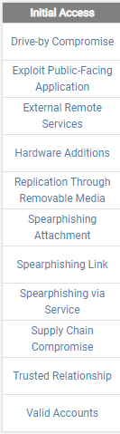
技術
Techniques
「Drive by download」路過式下載是利用系統、應用程式和瀏覽器的漏洞植入惡意程式的一種攻擊手段。網友即使只是瀏覽網站,也會在不知不覺中被迫下載惡意程式
Drive by download
路過式下載
（或稱為
隱藏式下載、
偷渡式下載、
強迫下載， 網頁掛馬）
https://blog.trendmicro.com.tw/?cat=2713

Slide 31
Discovery| Domain Trust Discovery
https://attack.mitre.org/techniques/T1482/
Adversaries may attempt to gather information on domain trust relationships that may be used to identify Lateral Movement (橫向攻擊)opportunities in Windows multi-domain/forest environments.
Domain trusts provide a mechanism for a domain to allow access to resources based on the authentication procedures of another domain.
Domain trusts allow the users of the trusted domain to access resources in the trusting domain.
The information discovered may help the adversary conduct SID-History Injection, Pass the Ticket, and Kerberoasting.
Domain trusts can be enumerated using the DSEnumerateDomainTrusts() Win32 API call, .NET methods, and LDAP.
The Windows utility Nltest is known to be used by adversaries to enumerate domain trusts.

Slide 32
Discovery| Domain Trust Discovery
使用方式: nltest [/OPTIONS]
nltest /?
/SERVER:<ServerName> - 指定 <ServerName>
/QUERY – 查詢 <ServerName> netlogon 服務
/REPL – 強制在 <ServerName> BDC 上進行部分同步
/SYNC - 強制在 <ServerName> BDC 上進行完整同步
/PDC_REPL – 強制 UAS 變更來自 <ServerName> PDC 的訊息
/SC_QUERY:<DomainName> - 查詢 <ServerName> 上 <Domain> 的 安全通道
/SC_RESET:<DomainName>[\<DcName>] – 將 <ServerName> 上 <Domain> 的安全通道重設為 <DcName>
/SC_VERIFY:<DomainName> - 驗證 <ServerName> 上 <Domain> 的安全通道
/SC_CHANGE_PWD:<DomainName> - 變更 <ServerName> 上 <Domain> 的安全通道密碼
/DCLIST:<DomainName> - 取得 <DomainName> 的 DC 清單
/DCNAME:<DomainName> - 取得 <DomainName> 的 PDC 名稱

Slide 33
/DSGETDC:<DomainName> - 呼叫 DsGetDcName /PDC /DS /DSP /GC /KDC
/TIMESERV /GTIMESERV /WS /NETBIOS /DNS /IP /FORCE /WRITABLE /AVOIDSELF /LDAPONLY /BACKG /DS_6 /DS_8 /DS_9 /DS_10
/TRY_NEXT_CLOSEST_SITE /SITE:<SiteName> /ACCOUNT:<AccountName> /RET_DNS /RET_NETBIOS
/DNSGETDC:<DomainName> - 呼叫 DsGetDcOpen/Next/Close /PDC /GC
/KDC /WRITABLE /LDAPONLY /FORCE /SITESPEC
/DSGETFTI:<DomainName> - 呼叫 DsGetForestTrustInformation
/UPDATE_TDO
/DSGETSITE - 呼叫 DsGetSiteName
/DSGETSITECOV - 呼叫 DsGetDcSiteCoverage
/DSADDRESSTOSITE:[MachineName] - 呼叫 DsAddressToSiteNamesEx
/ADDRESSES:<Address1,Address2,...>
/PARENTDOMAIN – 取得這部電腦的父系網域名稱
/WHOWILL:<Domain>* <User> [<Iteration>] – 查看 <User> 是 否可登入 <Domain>
/FINDUSER:<User> - 查看 <User> 可登入哪些信任網域
/TRANSPORT_NOTIFY – 通知 netlogon 有新的傳輸

Slide 34
/DBFLAG:<HexFlags> - 新的偵錯旗標
/USER:<UserName> - 查詢 <ServerName> 上的使用者資訊
/TIME:<Hex LSL> <Hex MSL> - 將 NT GMT 時間轉換為 ASCII
/LOGON_QUERY - 查詢累積的嘗試登入次數
/DOMAIN_TRUSTS – 查詢 <ServerName> 上的網域信任
/PRIMARY /FOREST /DIRECT_OUT /DIRECT_IN /ALL_TRUSTS /V
/DSREGDNS - 強制登錄所有 DC 特定 DNS 記錄
/DSDEREGDNS:<DnsHostName> - 解除登錄所指定 DC 的 DC 特定 DNS 記錄
/DOM:<DnsDomainName> /DOMGUID:<DomainGuid> /DSAGUID:<DsaGuid>
/DSQUERYDNS - 查詢所有 DC 特定 DNS 記錄的最後更新狀態
/BDC_QUERY:<DomainName> - 查詢 <DomainName> 的 BDC 複寫狀 態
/LIST_DELTAS:<FileName> - 顯示所指定變更記錄檔的內容
/CDIGEST:<Message> /DOMAIN:<DomainName> - 取得用戶端摘要
/SDIGEST:<Message> /RID:<RID in hex> - 取得伺服器摘要
/SHUTDOWN:<Reason> [<Seconds>] – 因為 <Reason>，關閉 <ServerName>
/SHUTDOWN_ABORT - 中止系統關機

Slide 35
複選
Windows作業系統提供一nltest工具用來進行系統管理,有關此工具的敘述下列何者為是?
nltest工具可用來列舉windows網域的信任關係
nltest工具可使用/LOGON_QUERY 來查詢累積的嘗試登入次數

